Slide 1
UniHD at TSAR-2022 Shared Task: Is Compute All We Need for Lexical Simplification?
Dennis Aumiller and Michael Gertz Heidelberg University Institute of Computer Science Database Systems Research Group aumiller@informatik.uni-heidelberg.de

Slide 2
Current Simplification Systems
Complex Word
*: requires external knowledge/tooling
Source: Qiang et al., 2020: LSBert: A Simple Framework for Lexical Simplification
Aumiller and Gertz: “UniHD at TSAR-2022: Is Compute All We Need for Lexical Simplification?”
2

Slide 3
Current Simplification Systems
Complex Word
Stemming*
*: requires external knowledge/tooling
Source: Qiang et al., 2020: LSBert: A Simple Framework for Lexical Simplification
Aumiller and Gertz: “UniHD at TSAR-2022: Is Compute All We Need for Lexical Simplification?”
2

Slide 4
Current Simplification Systems
Complex Word
Stemming*
Substitute
Generation*
*: requires external knowledge/tooling
Source: Qiang et al., 2020: LSBert: A Simple Framework for Lexical Simplification
Aumiller and Gertz: “UniHD at TSAR-2022: Is Compute All We Need for Lexical Simplification?”
2

Slide 5
Current Simplification Systems
Complex Word
Stemming*
Statistical
Features
Substitute
Generation*
*: requires external knowledge/tooling
Source: Qiang et al., 2020: LSBert: A Simple Framework for Lexical Simplification
Aumiller and Gertz: “UniHD at TSAR-2022: Is Compute All We Need for Lexical Simplification?”
2

Slide 6
Current Simplification Systems
Paraphrase
Database*
Complex Word
Stemming*
Statistical
Features
Substitute
Generation*
*: requires external knowledge/tooling
Source: Qiang et al., 2020: LSBert: A Simple Framework for Lexical Simplification
Aumiller and Gertz: “UniHD at TSAR-2022: Is Compute All We Need for Lexical Simplification?”
2

Slide 7
Current Simplification Systems
Paraphrase
Database*
Complex Word
Stemming*
Statistical
Features
Inflection*
Substitute
Generation*
*: requires external knowledge/tooling
Source: Qiang et al., 2020: LSBert: A Simple Framework for Lexical Simplification
Aumiller and Gertz: “UniHD at TSAR-2022: Is Compute All We Need for Lexical Simplification?”
2

Slide 8
Current Simplification Systems
Paraphrase
Database*
Complex Word
Stemming*
Statistical
Features
Inflection*
Substitute
Generation*
*: requires external knowledge/tooling
Source: Qiang et al., 2020: LSBert: A Simple Framework for Lexical Simplification
Aumiller and Gertz: “UniHD at TSAR-2022: Is Compute All We Need for Lexical Simplification?”
2

Slide 9
Wishful Thinking
A simple pipeline, that could do all of that (but better)?
No domain-specific resources required
No tedious adaptation to new domains/languages
Aumiller and Gertz: “UniHD at TSAR-2022: Is Compute All We Need for Lexical Simplification?”
3

Slide 10
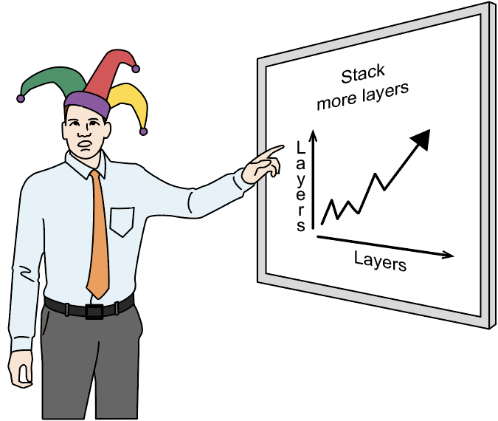
Wishful Thinking
A simple pipeline, that could do all of that (but better)?
No domain-specific resources required
No tedious adaptation to new domains/languages
Source: https://freecontent.manning.com/neural-network-architectures/
Aumiller and Gertz: “UniHD at TSAR-2022: Is Compute All We Need for Lexical Simplification?”
3

Slide 11
Contributions
Consider very large LMs as zero-shot recommenders for few-shot (contextualized) Lexical Simplification
Improve prediction diversity and coverage by sampling from multiple system prompts
Aumiller and Gertz: “UniHD at TSAR-2022: Is Compute All We Need for Lexical Simplification?”
4
Notes:
Later point: ”Suitable for summarization”, i.e. their expected input/output lengths are more towards the example that we’ve shown.

Slide 12
The Magical World of Prompt Design

Slide 13
Task Setup
Shared task trial data: only 10 labeled samples
Require great zero-shot performance
Post-filtering as quality control
Source: Wei et al., 2022: Emergent Abilities of Large Language Models
Aumiller and Gertz: “UniHD at TSAR-2022: Is Compute All We Need for Lexical Simplification?”
6

Slide 14
Task Setup
Shared task trial data: only 10 labeled samples
Require great zero-shot performance
Post-filtering as quality control
Complex Word
Substitute
Generation
Filtering
Aumiller and Gertz: “UniHD at TSAR-2022: Is Compute All We Need for Lexical Simplification?”
6

Slide 15
Model Considerations
Large enough to exhibit emergent behavior
>60B parameters
Provide reasonable API or inference endpoints
Explicitly trained on (at least) one shared task lang
Consider “parameters per language” in train data
Source: Wei et al., 2022: Emergent Abilities of Large Language Models
Aumiller and Gertz: “UniHD at TSAR-2022: Is Compute All We Need for Lexical Simplification?”
7

Slide 16
Model Considerations
Large enough to exhibit emergent behavior
>60B parameters
Provide reasonable API or inference endpoints
Explicitly trained on (at least) one shared task lang
Consider “parameters per language” in train data
Went with GPT-3 (text-davinci-002)
Source: Wei et al., 2022: Emergent Abilities of Large Language Models
Aumiller and Gertz: “UniHD at TSAR-2022: Is Compute All We Need for Lexical Simplification?”
7

Slide 17
Play around, Find out
Finding the “best” prompt is difficult
No observable gradients
Inference costs
Bigger models -> higher prompt tolerance
Aumiller and Gertz: “UniHD at TSAR-2022: Is Compute All We Need for Lexical Simplification?”
8

Slide 18
Play around, Find out
Finding the “best” prompt is difficult
No observable gradients
Inference costs
Bigger models -> higher prompt tolerance
Aumiller and Gertz: “UniHD at TSAR-2022: Is Compute All We Need for Lexical Simplification?”
8

Slide 19
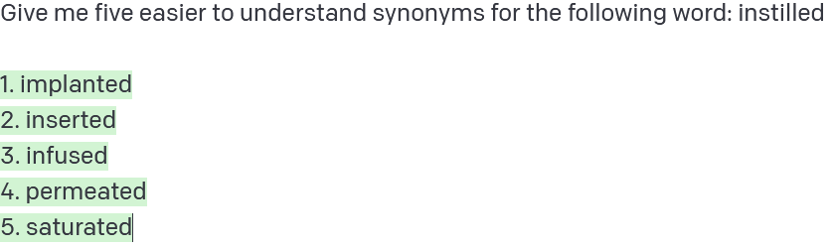
Play around, Find out
Finding the “best” prompt is difficult
No observable gradients
Inference costs
Bigger models -> higher prompt tolerance
Aumiller and Gertz: “UniHD at TSAR-2022: Is Compute All We Need for Lexical Simplification?”
8

Slide 20
Play around, Find out
Finding the “best” prompt is difficult
No observable gradients
Inference costs
Bigger models -> higher prompt tolerance
Aumiller and Gertz: “UniHD at TSAR-2022: Is Compute All We Need for Lexical Simplification?”
8

Slide 21
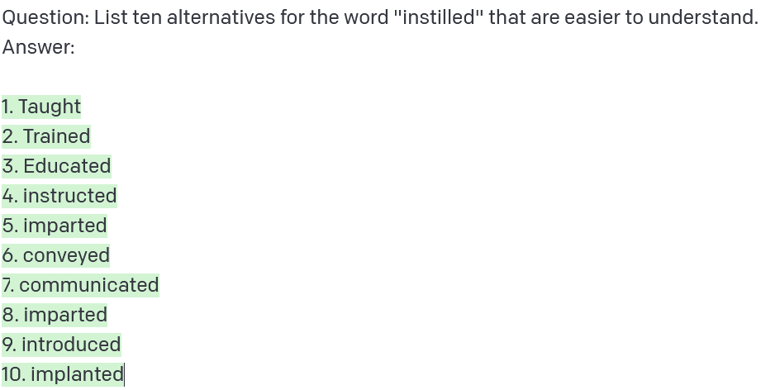
Ensuring Structured Outputs
“Exam question trick”
Adding explicit cues improves consistency
Still no guarantee for consistency!
Aumiller and Gertz: “UniHD at TSAR-2022: Is Compute All We Need for Lexical Simplification?”
9

Slide 22
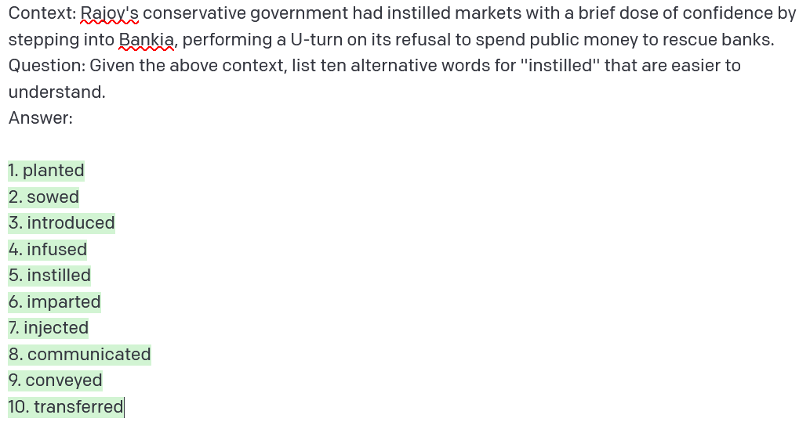
Incorporating Context
Downside: More context -> higher inference cost
Aumiller and Gertz: “UniHD at TSAR-2022: Is Compute All We Need for Lexical Simplification?”
10

Slide 23
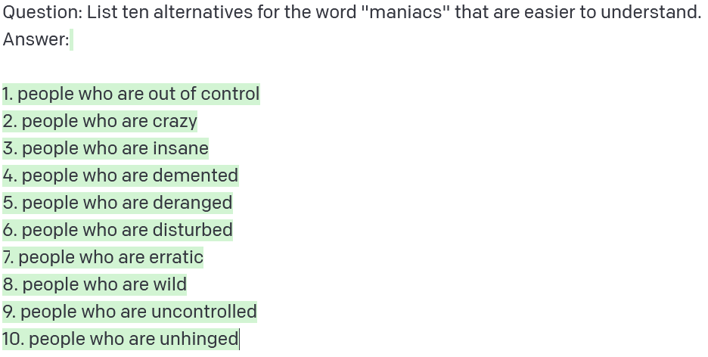
Filtering
Merge different output formats
Filter identity predictions & repetitions
Remove verbose substitutes
Aumiller and Gertz: “UniHD at TSAR-2022: Is Compute All We Need for Lexical Simplification?”
11

Slide 24
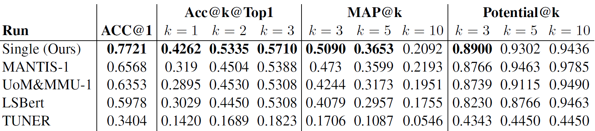
Official Results
Particularly impressive @1 & @3 performance
@10 performance drops of
Aumiller and Gertz: “UniHD at TSAR-2022: Is Compute All We Need for Lexical Simplification?”
12

Slide 25
Improving Coverage of Predictions

Slide 26
Improving Coverage
Filtering removes “too many” candidates
Candidate sets can be homogenous
Order of candidates suboptimal
Aumiller and Gertz: “UniHD at TSAR-2022: Is Compute All We Need for Lexical Simplification?”
14

Slide 27
Improving Coverage
Filtering removes “too many” candidates
Candidate sets can be homogenous
Order of candidates suboptimal
Idea: Query with multiple (different) prompts!
Add few-shot examples
With/Without context sentence
Aumiller and Gertz: “UniHD at TSAR-2022: Is Compute All We Need for Lexical Simplification?”
14

Slide 28
Merging Predictions
Assign scores to each prompt-specific result set
Aggregate & re-rank based on total score
Cut down to k predictions
Prompt 1
Prompt 2
3
fixed
3
infused
2
filled
2
introduced
1
infused
1
created
Aumiller and Gertz: “UniHD at TSAR-2022: Is Compute All We Need for Lexical Simplification?”
15

Slide 29
Merging Predictions
Assign scores to each prompt-specific result set
Aggregate & re-rank based on total score
Cut down to k predictions
4
infused
Prompt 1
Prompt 2
fixed
infused
3
fixed
3
3
2
filled
2
introduced
2
filled
1
infused
1
created
2
introduced
1
created
Aumiller and Gertz: “UniHD at TSAR-2022: Is Compute All We Need for Lexical Simplification?”
15

Slide 30
Merging Predictions
Assign scores to each prompt-specific result set
Aggregate & re-rank based on total score
Cut down to k predictions
4
infused
Prompt 1
Prompt 2
fixed
infused
3
fixed
4
infused
3
3
2
filled
2
introduced
2
filled
3
fixed
1
infused
1
created
2
introduced
2
filled
1
created
Aumiller and Gertz: “UniHD at TSAR-2022: Is Compute All We Need for Lexical Simplification?”
15

Slide 31
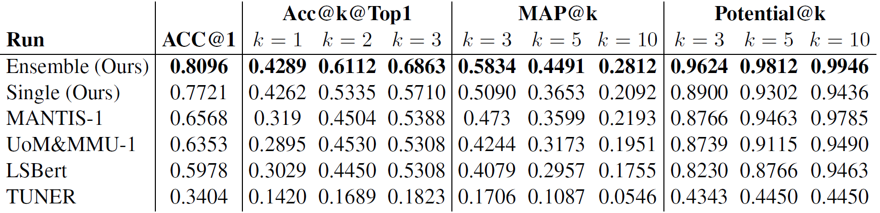
Updated Results
Slight improvements @1
Drastically improved @10 performance
Aumiller and Gertz: “UniHD at TSAR-2022: Is Compute All We Need for Lexical Simplification?”
16

Slide 32
Bonus: Multilingual Extension

Slide 33
Language Transfer with LLMs
What if we “ask nicely”?
Aumiller and Gertz: “UniHD at TSAR-2022: Is Compute All We Need for Lexical Simplification?”
18

Slide 34
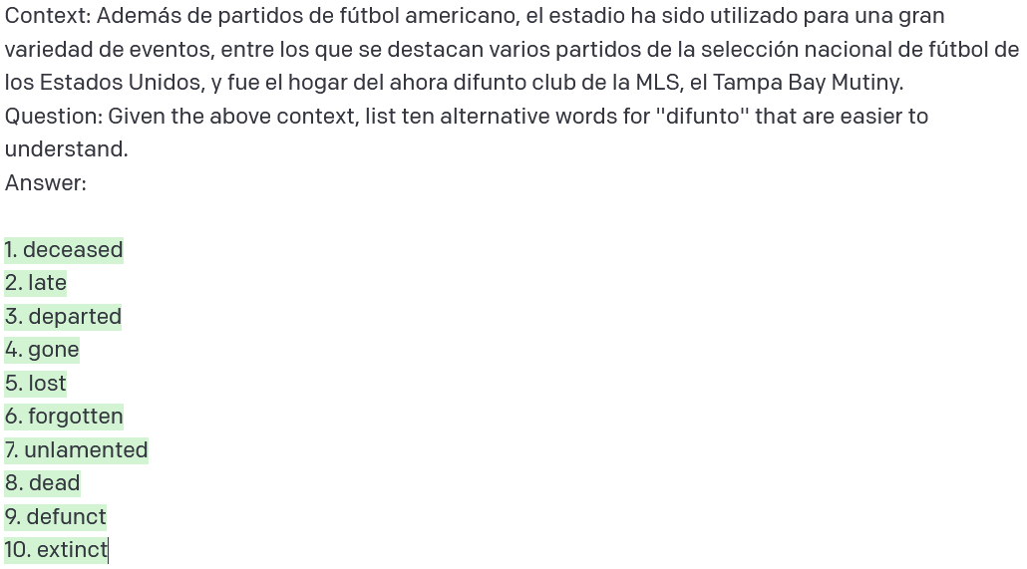
Language Transfer with LLMs
What if we “ask nicely”?
Aumiller and Gertz: “UniHD at TSAR-2022: Is Compute All We Need for Lexical Simplification?”
18

Slide 35
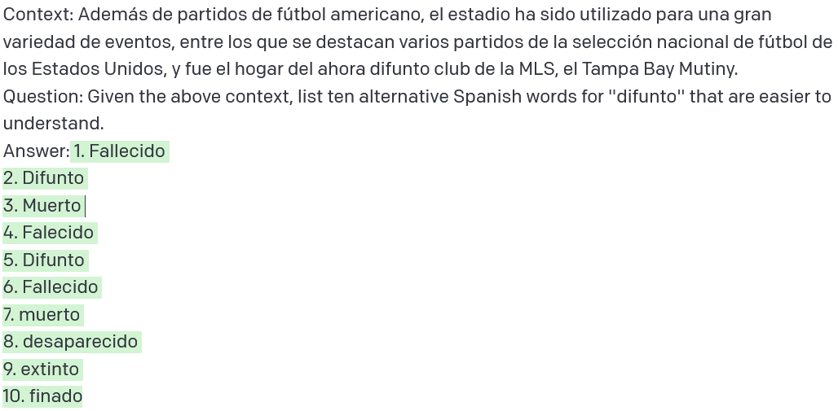
Language Transfer with LLMs
What if we “ask nicely”?
Aumiller and Gertz: “UniHD at TSAR-2022: Is Compute All We Need for Lexical Simplification?”
18

Slide 36
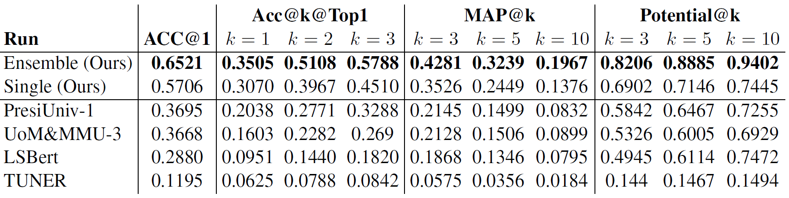
Spanish and Portuguese Results
Spanish:
Aumiller and Gertz: “UniHD at TSAR-2022: Is Compute All We Need for Lexical Simplification?”
19

Slide 37
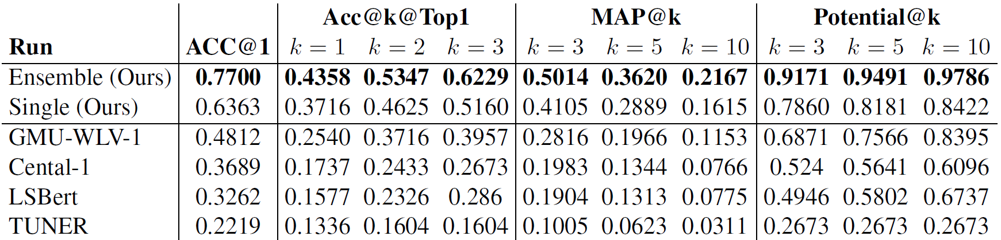
Spanish and Portuguese Results
Spanish:
Portuguese:
Aumiller and Gertz: “UniHD at TSAR-2022: Is Compute All We Need for Lexical Simplification?”
19

Slide 38
Take Away and Limitations

Slide 39
Is Compute All We Need?
Maybe?
Great performance
Expensive inference
Hard to steer generation
Useful for silver labels?
Aumiller and Gertz: “UniHD at TSAR-2022: Is Compute All We Need for Lexical Simplification?”
21

Slide 40

Thank you for your attention!
Code: https://github.com/dennlinger/TSAR-2022-Shared-Task
Any questions?
@d_aumiller
aumiller@informatik.uni-heidelberg.de

Slide 41
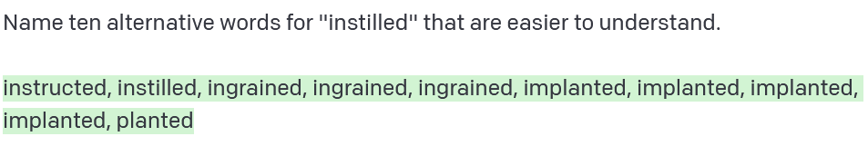
Alternative Models:
Smaller models struggle with coherence
Aumiller and Gertz: “UniHD at TSAR-2022: Is Compute All We Need for Lexical Simplification?”
41

Slide 42
All Promts:
TODO
Aumiller and Gertz: “UniHD at TSAR-2022: Is Compute All We Need for Lexical Simplification?”
42

Slide 43
Reading a Simplified Article
Constructing the Klexikon Dataset
Exploratory Analysis
Future Work
Aumiller and Gertz: “Klexikon: A German Dataset for Joint Summarization and Simplification”
43

